Slide 1
REALTOR 2025
INLAND VALLEYS ASSOCIATION OF REALTORS – JUNE 27TH, 2019

Slide 2
Raise your hand if you subscribe to Netflix
in 2019, there are 39 million "cord-cutters" ... defined as people over the age of 18 that rely on the Internet and no longer have access to traditional pay TV services (that's 15% of the US population)
Who here still uses a "flip-phone"?.... don't be embarrassed.. we know who you are...
in 2019, there are 250 million people in the US using smartphones (that's 70% of the US population)
Is there anyone here that fills-out their tax returns using paper and pencil?... Anyone?
in 2019, over 92% of IRS tax returns were filed electronically.
So, what you've told me is.... we love it when technology is fast, affordable, and convenient.

Slide 3
How people interact with computers has gone from INTIMIDATING to…. INTIMATE

Slide 4
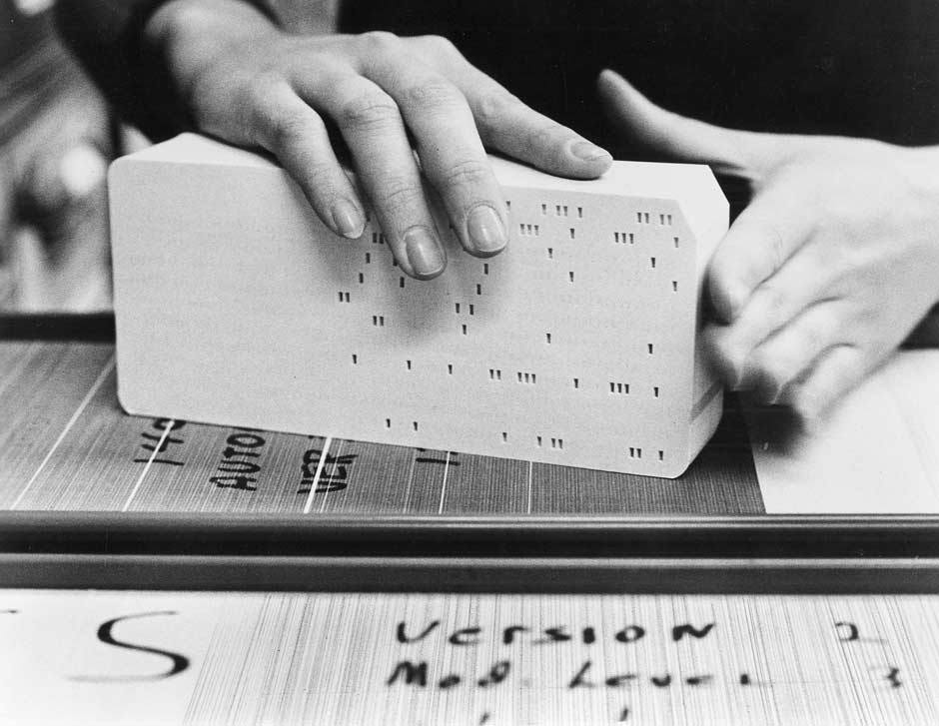
To get a computer to do something…
1950’s – People would have to punch holes in a paper “card”.
And, the computer was in the BASEMENT.

Slide 5
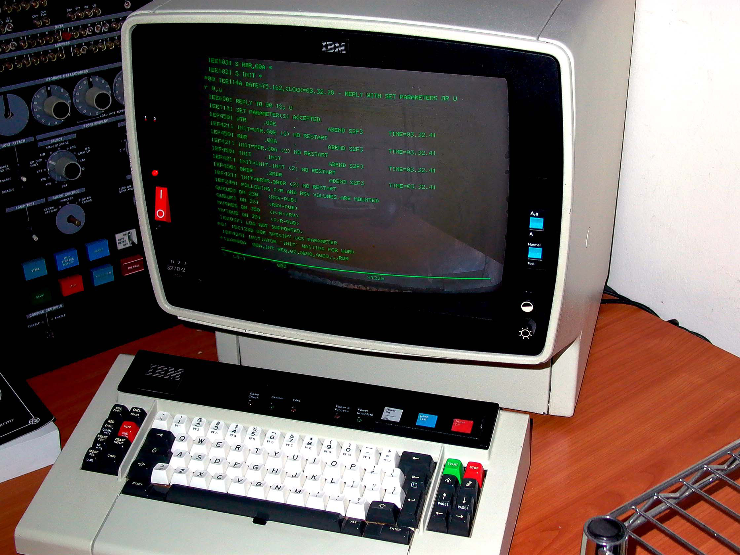
To get a computer to do something…
1970’s – Then, you could type on a keyboard.
But, the computer was STILL in the BASEMENT.

Slide 6
To get a computer to do something…
1980’s – Then, you could use a mouse.
And, the computer was on your DESK.

Slide 7
To get a computer to do something…
2000’s – Then, you used your FINGER.
And, the computer was in your HAND.

Slide 8
To get a computer to do something…
2010’s – Now, you control the computer with your VOICE.
And, the computer is in the CLOUD.

Slide 9
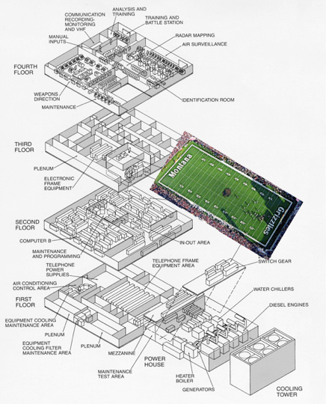
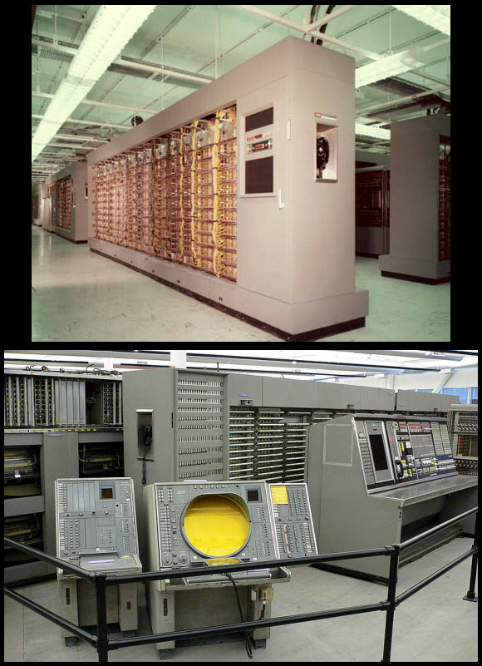
IN ONE LIFETIME WE HAVE GONE FROM …
1950’s - AN/FSQ-7
50,000 vacuum tubes
256K bytes storage
2018 iPhone XS
16,000 = 1

Slide 10
Even the smallest hands now EXPECT to hold more computing power than a 1950’s mainframe that was the size of a 3-STORY BUILDING…

Slide 11
AGENDA
Consumer-Centered Model
Tools/Applications
Realtor Opportunities

Slide 12
Consumer-Centered Model
“A better consumer experience will always be the key driver of change in the real estate industry”
“We want all of the following:”
Convenience
Transparency
Certainty about dates and dollars
Accurate Information
Responsiveness
Flexibility/Choices
Control over the process
Lower Fees
Higher Seller Prices/Lower Buyer Prices
Quicker Schedules

Slide 13
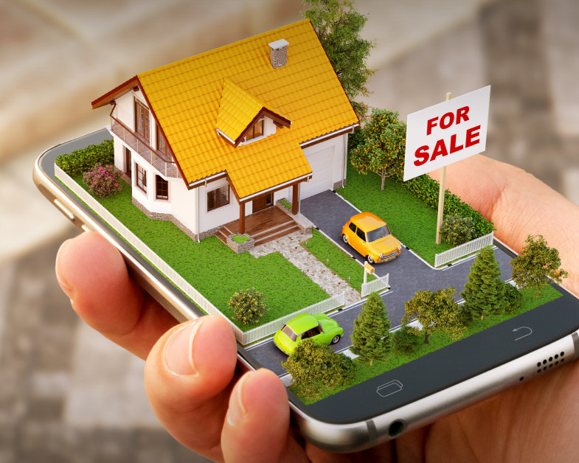
NEW TOOLS/APPLICATIONS
VUI
AI
VR & AR

Slide 14
“Interfaces to digital systems of the future will no longer be machine driven. They will be human centric”
Werner Vogels, Amazon’s chief technology officer
According to Statista, 39% of millennials use voice search.
11/2018

Slide 15
VOICE-ENABLED REAL-ESTATE TOOLS

Slide 16
Virtual Property Assistant

Slide 17
The role of AI is to predict and not to know.
It cannot know, because AI is about trying to understand an unknown event
(Scott Boding, vice president of risk solutions product management for Visa’s CyberSource)

Slide 18
Realogy is embracing AI technology through an exclusive partnership with Ojo Labs, a mobile app that promises to cultivate and nurture leads until they’re ready to be in direct contact with an agent.

Slide 19
MORE DATA = BETTER PREDICTIONS
Gary Keller statements
We’re in the age of machines that are “always on, always learning, always thinking.”
“AI can either be a partner or a competitor”.
“data is the new oil” … it’s the raw material that is worthless until refined/transformed into some useful product. But without data, there can be no ‘gasoline’.

Slide 20
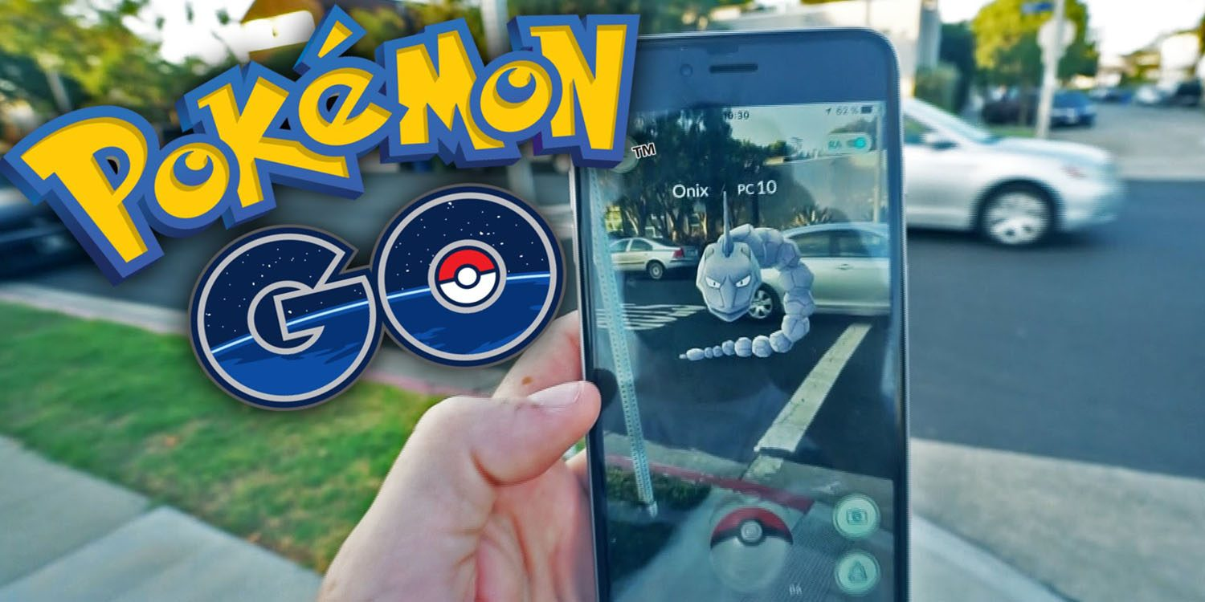
Augmented Reality allows the user to see the real world as it is right now, but with certain elements altered and manipulated.
Pokémon GO has $2.45 billion in revenue, 550 million downloads globally

Slide 21
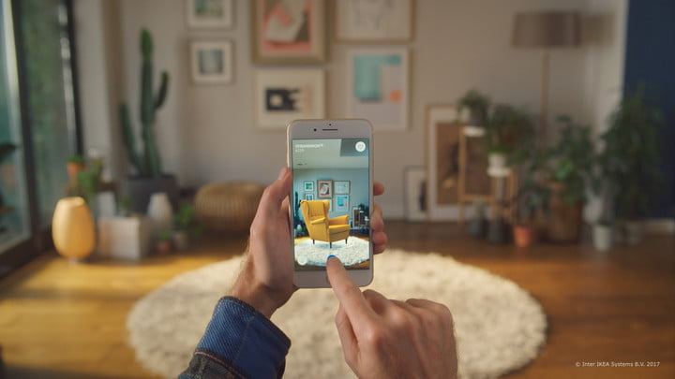
Ikea Place is an AR app that allows customers to try out IKEA furniture in a virtual environment before buying.
It can render accurate 3D images, giving customers realistic portrayal of how the items look in the real world.

Slide 22
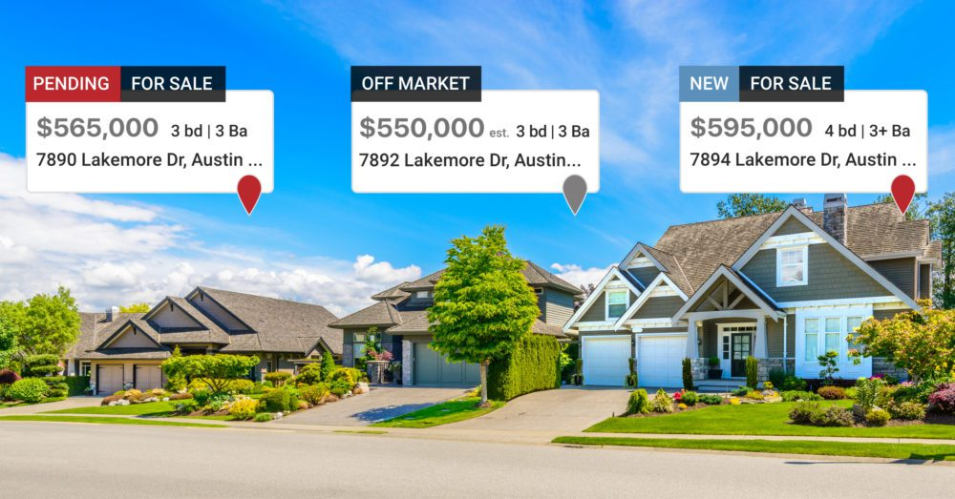
Realtor.com offers a real estate app has several AR features.
The consumer sees the price, the address, number of beds and baths, square footage, as well as real estate agent contacts. Just walking around neighborhoods and holding a phone you can find what houses are on sale.

Slide 24
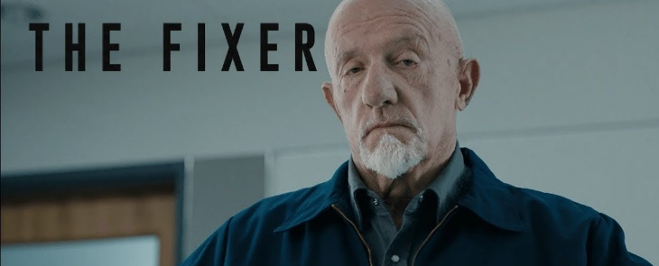
REALTOR OPPORTUNITIES
Realtors are fundamentally “Problem Solvers”… and we will always have value for that reason
“We are called to be architects of the future, not its victims.”
—R. Buckminster Fuller

Slide 25
Leverage Technology To……
Offer cost-competitive, highly-efficient transactions that…
Offer high-value, service-oriented transactions that…
…..Finding the right mix of “Customer Service” and “Technology”

Slide 26
Thank You
Van Romine - IT Manager
Inland valleys association of realtors

