Slide 2
NAR PRESIDENT BILL CHEE ADDRESSES THE BOARD OF DIRECTORS, WASHINGTON D.C.,
APRIL 26 1993

Slide 3
“WE REALTORS CANNOT BE A FEW CHIHUAHUAS FIGHTING OVER A BONE, WHILE THE LIONS ARE COMING OVER THE HILL”
BILL CHEE

Slide 4
“WHAT THE CONSUMER WANTS, THE CONSUMER GETS”
BILL CHEE

Slide 6
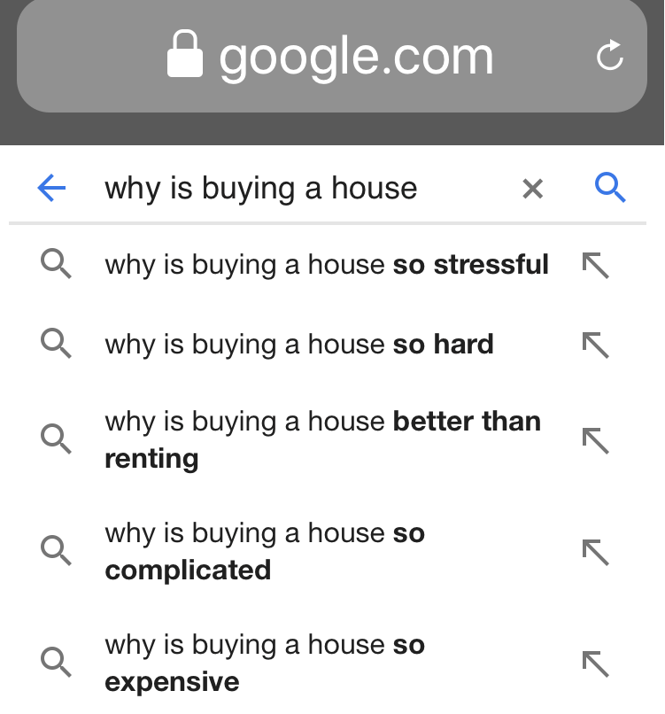

Slide 7
“BUYING AND SELLING HOUSES IS A COMPLICATED PROBLEM OF THE PHYSICAL UNIVERSE THAT CANNOT BE SOLVED BY ROBOTS ALONE. REAL ESTATE IS NOT E-COMMERCE; IT IS SOME COMBINATION OF HUMANS AND BOTS. AND IT IS SOLVED LOCALLY.”
BRAD INMAN

Slide 8
“LIFE IS CHANGE.
GROWTH IS OPTIONAL.
CHOOSE WISELY.”

